Slide 1

Chapter 4 Text Processing
SEG301m

Slide 2
Objectives
The techniques used in text processing
How to analyze the links?
How to extract information?

Slide 3
Contents
4.1 From Words to Terms
4.2 Text statistics
4.3 Document parsing: Tokenizing, stopping, stemming, phrases and N-grams
4.4 Document structure and markup
4.5 Link analysis: anchor text, page rank, link quality
4.6 Information Extraction: Hidden Markov models for extraction

Slide 4
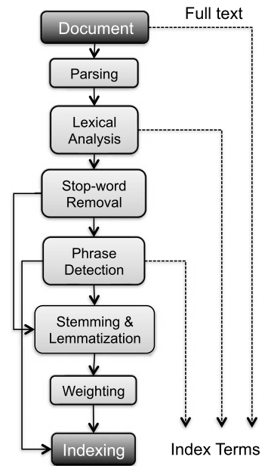
4.1 From Words to Terms
Textual preprocessing phase typically performed by an IR engine, taking as input a document and yielding its index terms
Generic terms
Conjunctions and prepositions
Low discriminative power
High term frequency
Specific terms
Higher discriminative power
Low document frequency

Slide 5
4.1 From Words to Terms
Document:
This is the input document (Full text), which can be an article, web page, or any other form of text.
Parsing:
The document is analyzed for its syntactic structure to identify elements in the text, such as sentences, paragraphs, and words.

Slide 6
4.1 From Words to Terms
Lexical Analysis:
This stage processes the content of the text into smaller components, usually words (tokens). This process helps to identify each meaningful word or character in the document.
Stop-word Removal:
Stop words are words that do not have much meaning in the content analysis, such as "the", "is", "at", etc. They are removed to reduce noise and optimize the results.

Slide 7
4.1 From Words to Terms
Phrase Detection:
After removing stop words, the system identifies important phrases in the text, usually compound nouns or meaningful noun phrases.
Stemming & Lemmatization:
Stemming: Reducing words to their root (e.g. "running" → "run").
Lemmatization: Converting words to their basic or more grammatically correct form based on context.

Slide 8
4.1 From Words to Terms
Weighting:
Words or phrases are assigned weights based on their importance in the document. Weights can be calculated using techniques such as TF-IDF.
Indexing:
Terms are stored as an index, ready to be retrieved in search queries.
Parallel Data Flow:
The dashed arrow indicates that intermediate steps (Parsing, Lexical Analysis, or other steps) can use the full text to assist in processing or term extraction

Slide 9
4.2 Text statistics
The word frequency distribution is very uneven: few words appear very frequently, and many words appear almost not at all.
For example, the two most common English words (the, of) represent 10% of all words that appear in a text document. In a large sample of text, 50% of the unique words appear only once.

Slide 10
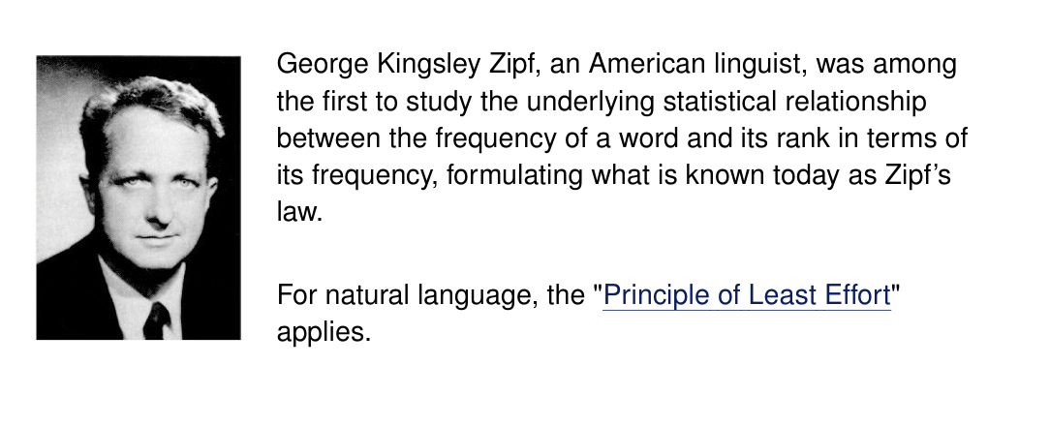
4.2 Text statistics

Slide 11
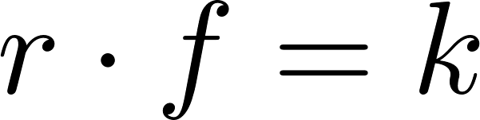
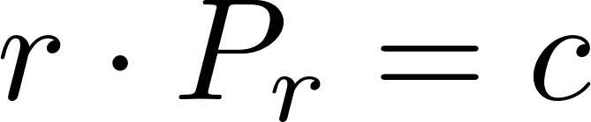

4.2 Text statistics
Zipf ’s law: the frequency of the rth most common word is inversely proportional to r or, alternatively, the rank of a word times its frequency (f) is approximately a constant (k)
The probability of occurrence for the rth ranked word is decided by
where c is a constant (For English, )
Notes:
4.2 Text statistics
Zipf ’s law: the frequency of the rth most common word is inversely proportional to r or, alternatively, the rank of a word times its frequency (f) is approximately a constant (k) r.f =k
The probability of occurrence for the rth ranked word is decided by r.Pr = c
where c is a constant (For English, c ~~ 0.1 )

Slide 12
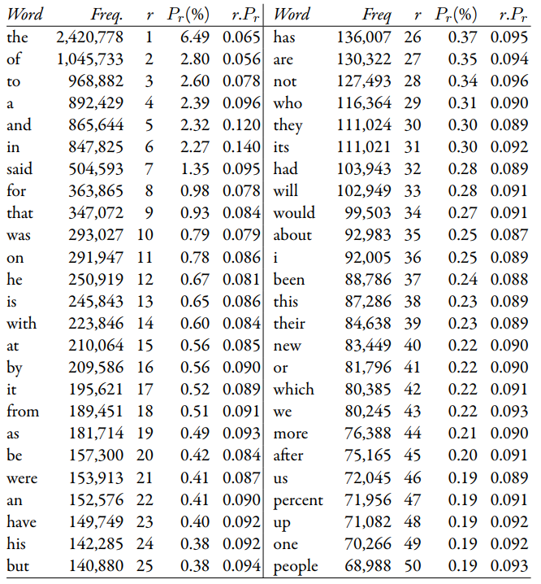
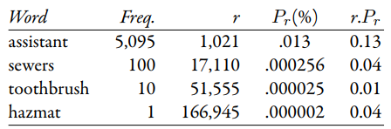
4.2 Text statistics
Most frequent 50 words from AP89 collection
Low frequency words
Từ "hazmat" là từ viết tắt của "hazardous material" (vật liệu nguy hiểm)

Slide 13
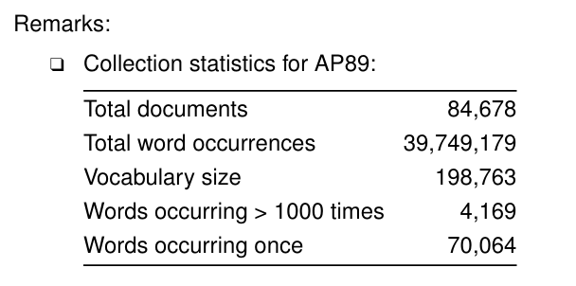
4.2 Text statistics

Slide 14
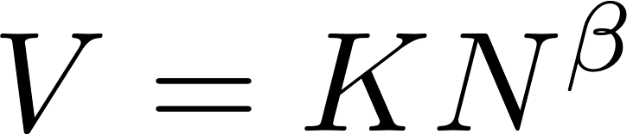
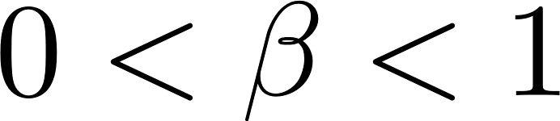
4.2 Text statistics: Vocabulary Growth
Heap’s Law. The above findings relate the frequency and relevance of words in a corpus
The vocabulary size V can be computed as
where N is the size (in words) of the document collection, K is a constant (10-100) and typically between 0.4 and 0.6
Notes:
Heaps’ law predicts that the number of new words will increase very rapidly when the corpus is small and will continue to increase indefnitely, but at a slower rate for larger corpora
Heap’s Law. The above findings relate the frequency and relevance of words in a corpus
The vocabulary size V can be computed as V = KN^Beta
where N is the size (in words) of the document collection, K is a constant (10-100) and 0< Beta < 1 typically between 0.4 and 0.6

Slide 15
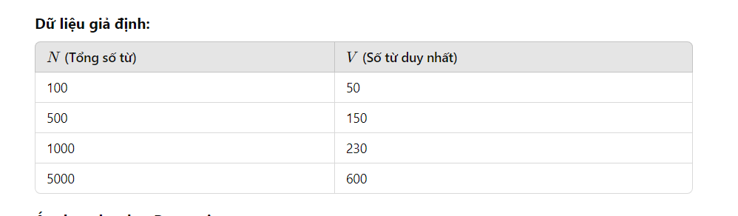
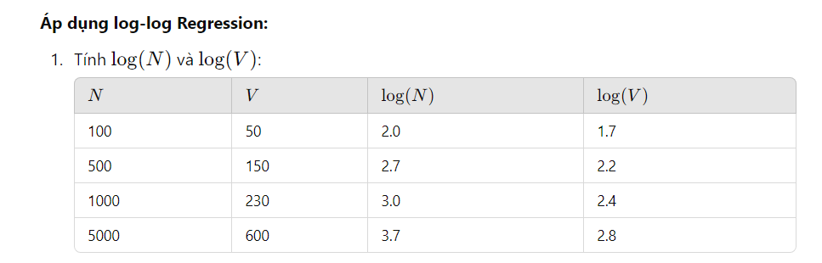
log(V)=log(K)+β⋅log(N)
log(K)=0.429; β= 0.647

Slide 16
4.3 Document parsing: Tokenizing
Tokenizing is the process of forming words from the sequence of characters in a document

Slide 17
4.3 Document parsing: Tokenizing
Issues?
Small words (one or two characters)
Both hyphenated and non-hyphenated forms of many words are common
Special characters
…

Slide 18
4.3 Document parsing: stopping
Determiners : “the,” “a,” “an,” “that,” and “those”
Prepositions: “over,” “under,” “above,” and “below,”
Stopwords: text processing stops when one is seen, and they are thrown out
Removing too many words: decrease retrieval effectiveness
Not removing stopwords : cause some problems in ranking

Slide 19
4.3 Document parsing: Stemming
A component of text processing that captures the relationships between different variations of a word
Two basic types of stemmers: algorithmic and dictionary-based
Algorithmic stemmer
cakes → cake, dogs → dog
“century” and “centuries”? : false negative
“I” and “is? : false positive
Notes:
It cannot detect many plural relationships, like “century” and “centuries”

Slide 20
4.3 Document parsing: Stemming
Replace sses by ss (e.g., stresses → stress)
Delete s if the preceding word part contains a vowel not immediately before the s (e.g., gaps → gap but gas → gas)
Replace ied or ies by i if preceded by more than one letter, otherwise by ie (e.g., ties → tie, cries → cri)
If suffix is us or ss do nothing (e.g., stress → stress)
Replace eed, eedly by ee if it is in the part of the word after the first non-vowel following a vowel (e.g., agreed → agree, feed → feed)
Delete ed, edly, ing, ingly if the preceding word part contains a vowel then if the word ends in at, bl, or iz add e (e.g., fished → fish, pirating → pirate)
Notes:
It cannot detect many plural relationships, like “century” and “centuries”

Slide 21
4.3 Document parsing: Stemming
Dictionary-based stemmer: store lists of related words in a large dictionary
The dictionary cannot be infinitely long, so it cannot react automatically to new words
Combine an algorithmic stemmer with a dictionary-based stemmer: Krovetz stemmer

Slide 22
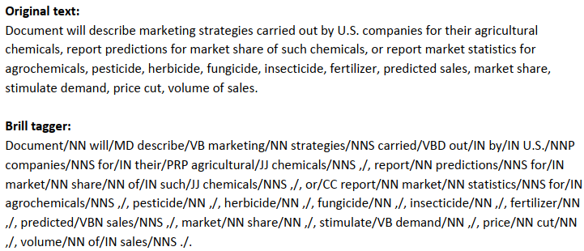
4.3 Document parsing: Phrases and N-grams
Noun phrase : sequences of nouns, or adjectives followed by nouns
Defined by part-of-speech (POS) tagger :
NN (singular noun), NNS (plural noun), VB (verb), VBD (verb, past tense), VBN (verb, past participle), IN (preposition), JJ (adjective), CC (conjunction, e.g., “and”, “or”), PRP (pronoun), and MD (modal auxiliary, e.g., “can”, will”)

Slide 23
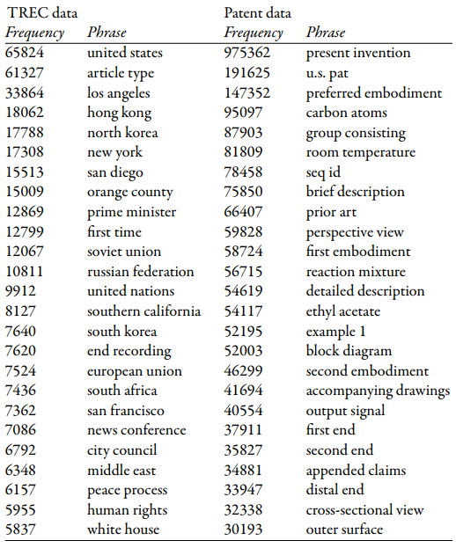
4.3 Document parsing: Phrases and N-grams
High-frequency simple noun phrases from a TREC corpus

Slide 24
4.3 Document parsing: Phrases and N-grams
Much simpler definition of a phrase: any sequence of n words, known as an n-gram
“to be or not to be” could certainly make use of n-grams
Use n-gram indexing: a fast method of incorporating phrase features in the ranking

Slide 25
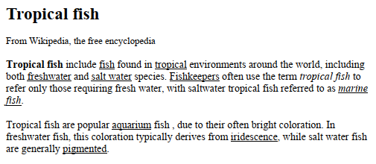
4.4 Document structure and markup
Fields or attributes of database records are a critical part of searching
Main heading for the page, “tropical fish”, indicates that this phrase is particularly important.
Other words and phrases are used as the anchor text

Slide 26

4.5 Link analysis
The words “the somewhere page” will be displayed differently than regular text, usually underlined or in a different color

Slide 27
4.5 Link analysis: anchor text
Two properties that make it particularly useful for ranking web pages
Very short, perhaps two or three words
Describe a destination page from a different perspective
Simple algorithm for ranking pages:
Search through all links in the collection, looking for anchor text that is an exact match for the user’s query.
Each time there is a match, add 1 to the score of the destination page
Pages would then be ranked in decreasing order of this score
www.ebay.com → “eBay”

Slide 28
4.5 Link analysis: PageRank
How can you type “tiki” into a search engine and it selects the most popular one?
inlinks (links pointing to a page): susceptible to spam
PageRank
PageRank: based on the idea of a random surfer

Slide 29
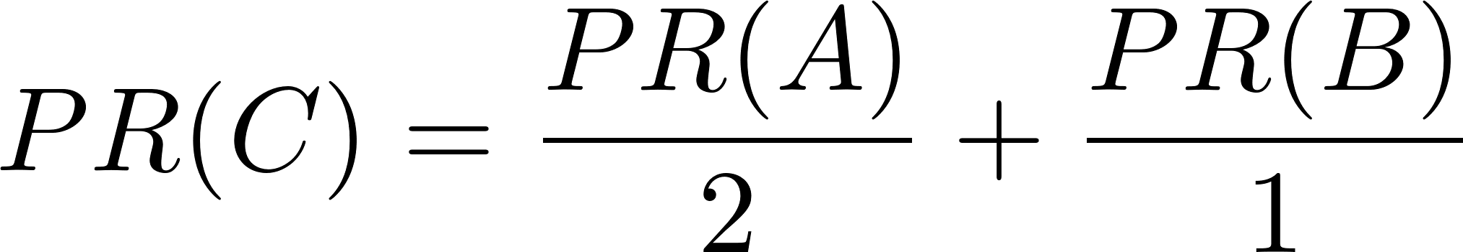
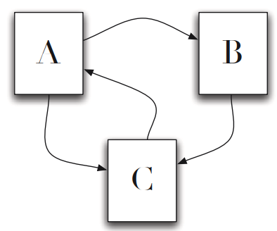
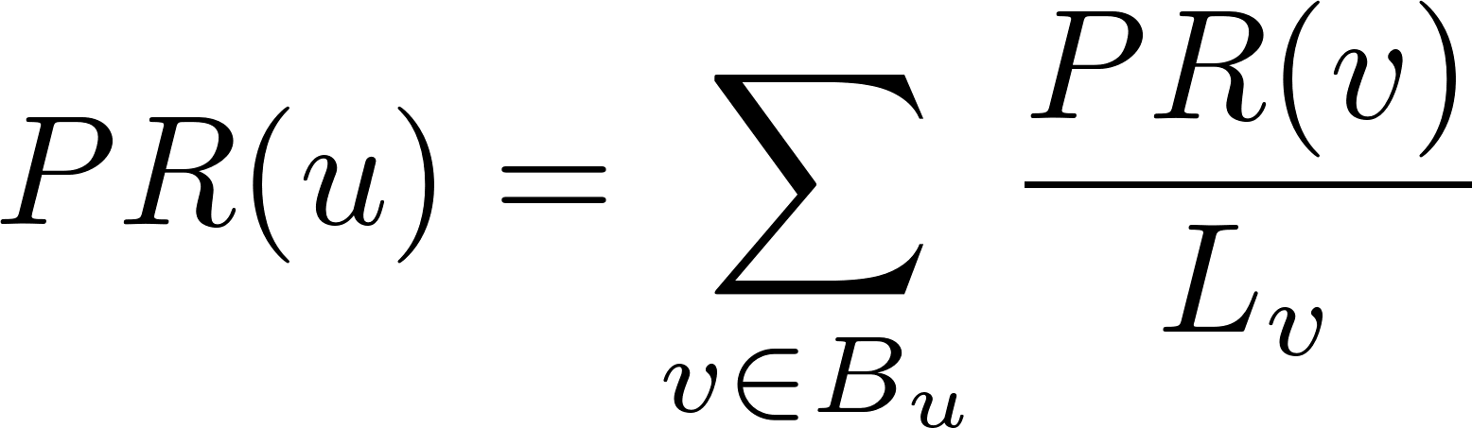
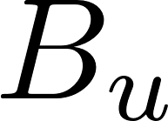
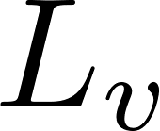
4.5 Link analysis: PageRank
The Web consists of just three pages, A, B, and C. We will suppose that page A links to pages B and C, page B links to page C, and page C links to page A
More generally, the PageRank for any page u
is the set of pages that point to u, and is the number of outgoing links from page v
Notes:
If we start by assuming that the PageRank values for all pages are the same (1/3 in this case), then it is easy to see that we could perform multiple iterations of the calculation.

Slide 30
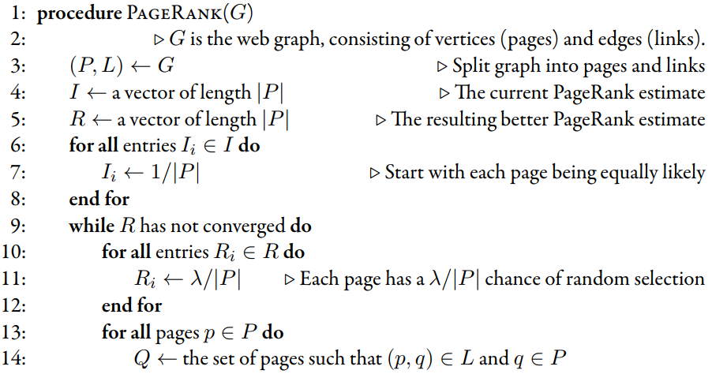
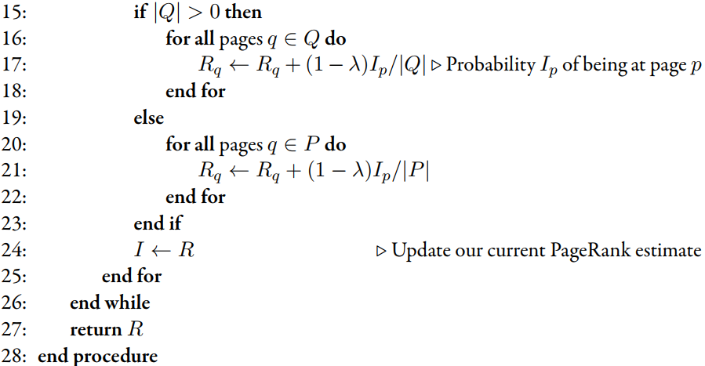
4.5 Link analysis: PageRank
Pseudocode for the iterative PageRank algorithm

Slide 31
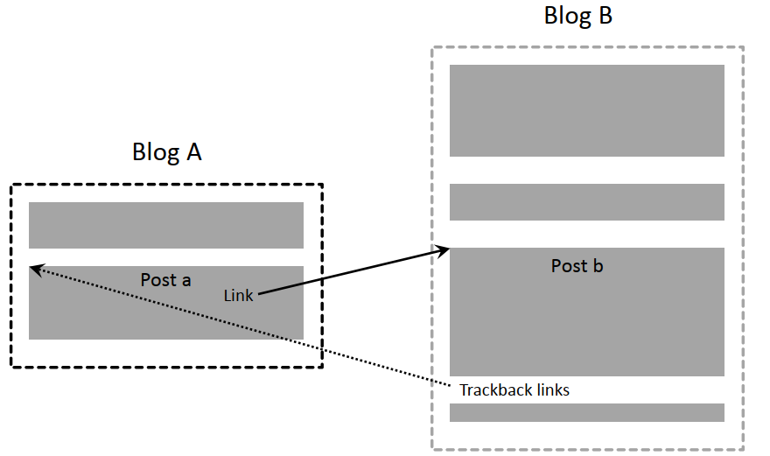
4.5 Link analysis: Link quality
Post b is inﬂuential, because author A has decided to write about it.
PageRank perspective, a and b have links to each other, and therefore neither is more inﬂuential than the other
Comments section of a blog
can also be a source of link spam
Notes:
Post a links to post b, and post b contains a trackback link to post a

Slide 32
4.5 Link analysis: Link quality
Solution: The link still appears on the blog, but search engines are designed to ignore all links marked rel=nofollow

Slide 33
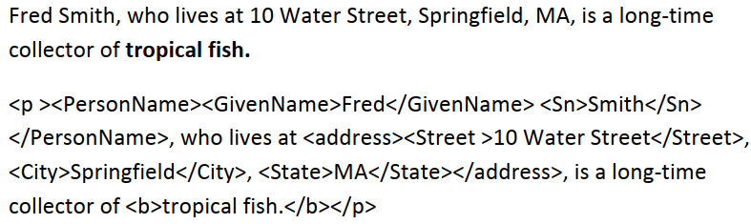
4.6 Information Extraction
Definition: a language technology that focuses on extracting structure from text
Text tagged by information extraction: a sentence and the corresponding XML markup after using information extraction

Slide 34
4.6 Information Extraction
Two main approaches for recognizing entity:
Rule-based approach
Statistical approach
Rule-based approach: uses one or more lexicons (lists of words and phrases) that categorize names
Statistical approach: use probabilistic model of the words and around an entity → Hidden Markov Model (HMM)

Slide 35
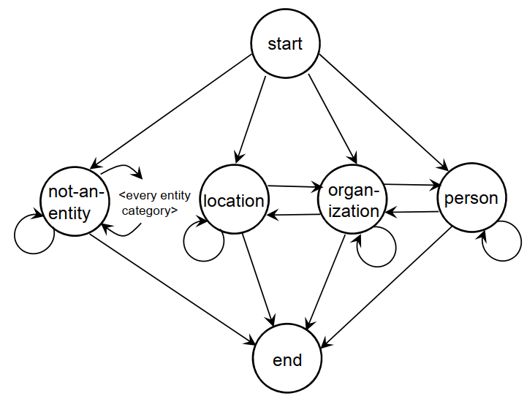
4.6 Information Extraction: Hidden Markov Model (HMM)
Problem: words can have many different meanings
“Marathon”: race or location?
Need context → next word in the sequence depends on only a small number of the previous words: HMM
Sentence model for statistical entity extractor

Slide 36
Exercise
Download several pages from Wikipedia. Then tokenize the collection you created. For this exercise, keep only the tokens consisting entirely of characters from the English alphabet. Ignore tags and tokens containing non-ASCII characters.

Slide 37
Summary
Document parsing: Tokenizing, stopping, stemming, phrases and N-grams
Link analysis: anchor text, page rank, link quality
Information Extraction: Hidden Markov models for extraction

